Slide 1
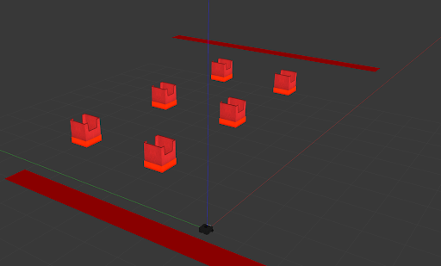
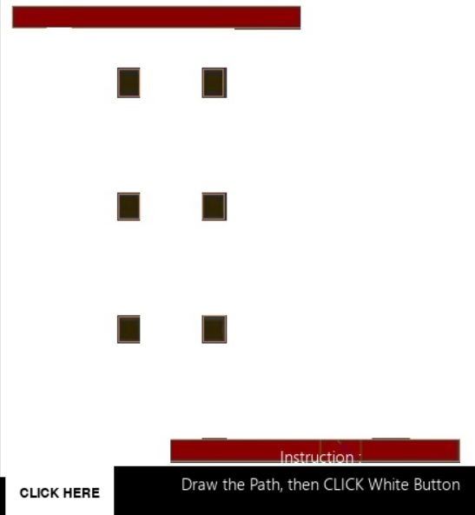
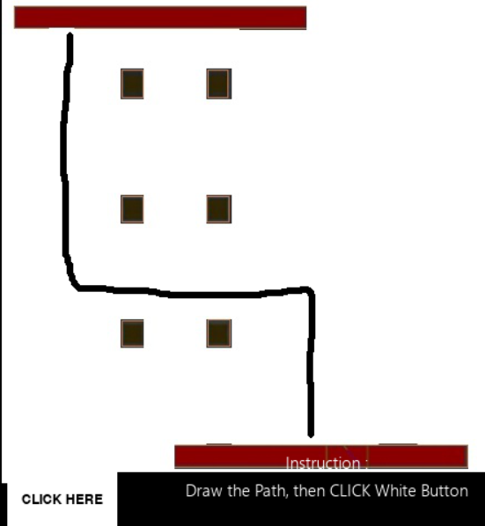
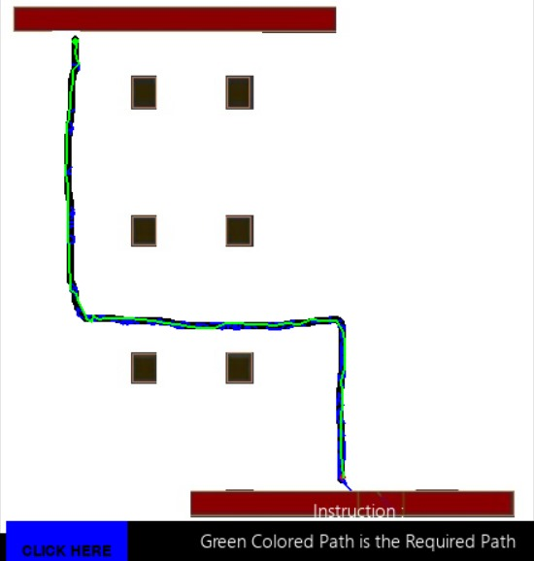
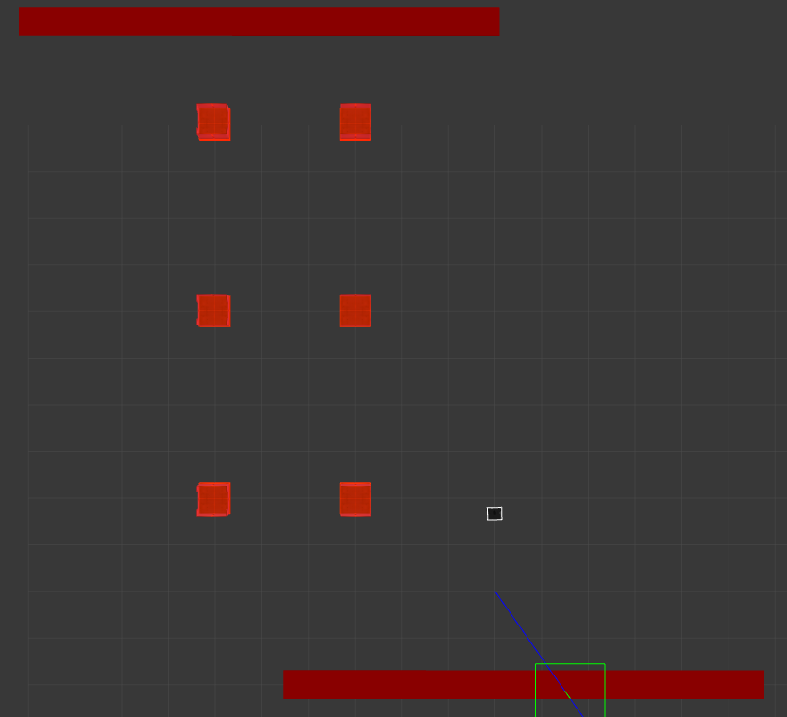
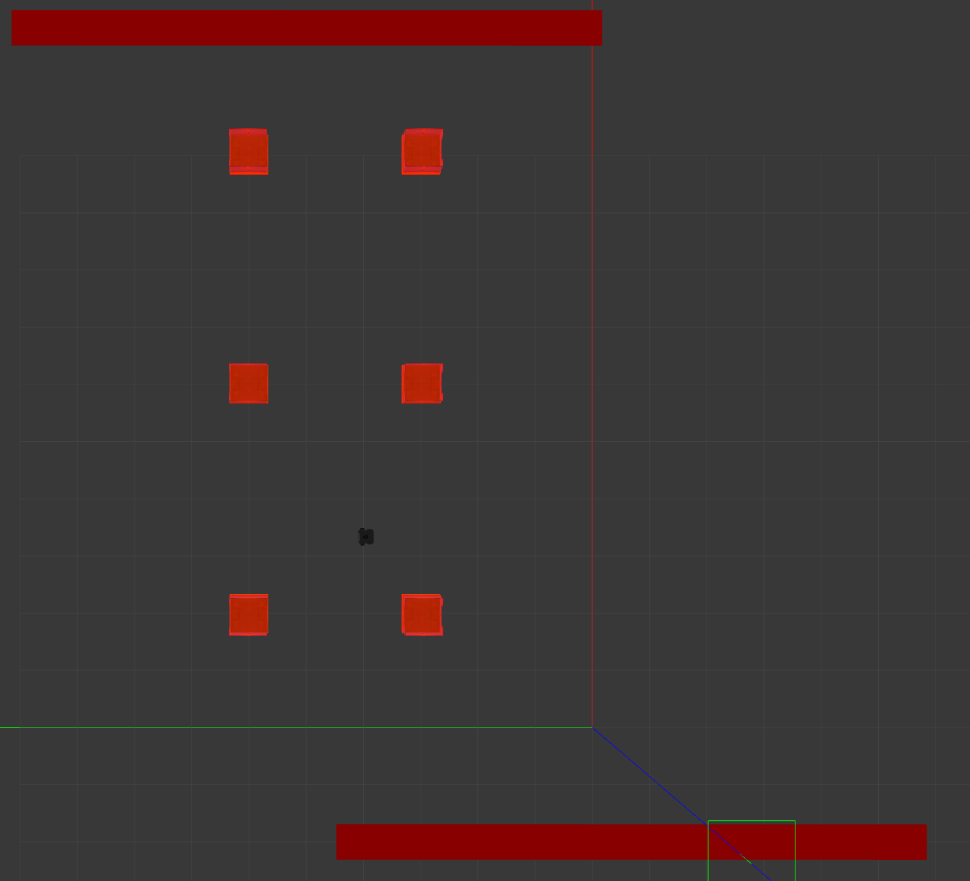
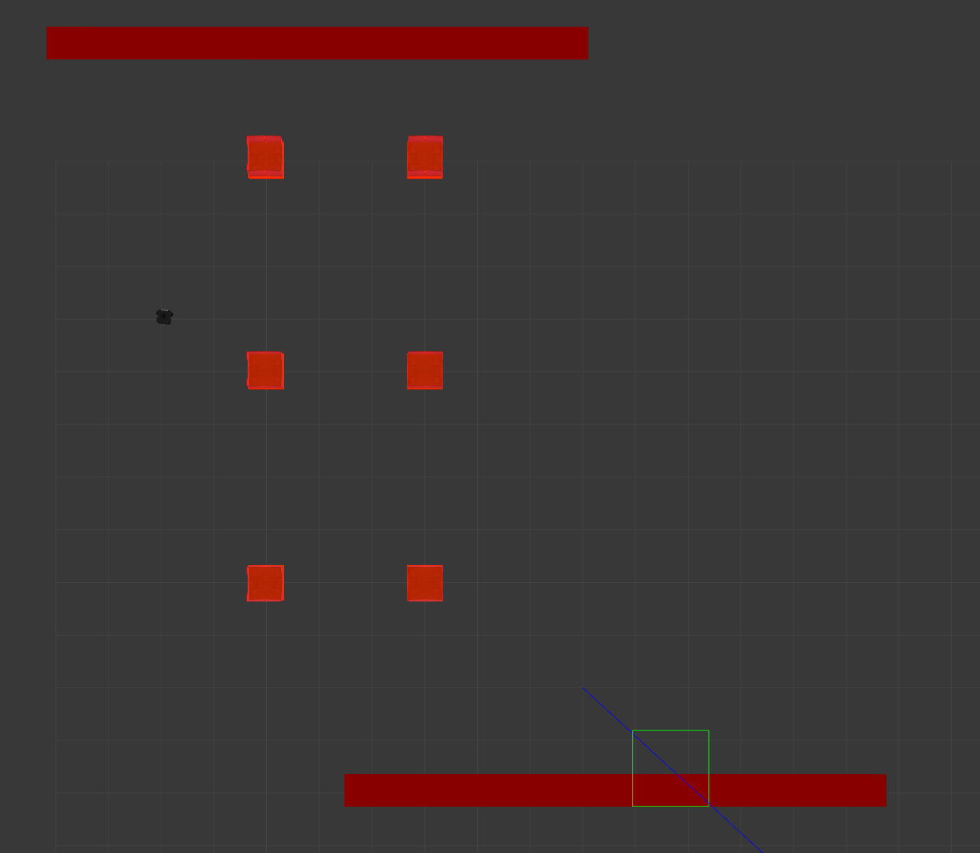



CSCI 5551-Intro to Rob
BagWati: Journeys By Your Design.
Group 12
Project Title: BagWati
Student Names: Rushikesh Zende (zende039@umn.edu), Rahul Autade (autad001@umn.edu), Vaibhava Krishna Devulapalli (devul009@umn.edu)
Environment Setup:
Receiver conveyor
Introduction:
BagWati is baggage transportation robot which traverses path based on the custom user input (path drawing on map).
Obstacles
Input-output:
Input- Path drawn on a map and processed with OpenCV.
Output- Robot traverses the custom path in gazebo along with performing baggage picking and dropping task.
Sender conveyor
Robot
Path Planning:
Method/Framework details:
Software mainly incorporates ROS1-noetic
For simulation purposes, Gazebo is used
For modelling and design, SolidWorks
Objects/Maps/Robots information:
Objects: A custom robot made using URDF tutorials from ROS wiki.
Maps: A world map built using models from opensource models (retrofitted in Gazebo).
Robot Description: A simple cubical box of dimensions (0.5 x 0.5 x0.5 Unit³ ) and wheels of (length =0.2 units and radius of 0.25 units)
Floor Map.
User Defined Input Path.
Path Tracing (RRT)
Traversal In Simulation:
References:
[1]Path Planning for Autonomous Mobile Robots: A Review https://www.researchgate.net/publication/356666030_Path_Planning_for_Autonomous_Mobile_Robots_A_Review
[2]Optimal Path Planning using RRT* based Approaches: A Survey and Future Directions
https://www.researchgate.net/publication/311394143_Optimal_Path_Planning_using_RRT_based_Approaches_A_Survey_and_Future_Directions
[3] wiki.ros.org

